Slide 1
AAA Companies Web Portal Help Guide

Slide 2
Learn About....
Logging into the AAA Web Portal
Services provided by AAA Properties Services
Route Maintenance Program
Creating a Service Request
Reviewing Service Tickets (open/closed)
Reviewing a Calendar of Scheduled Services
Creating a Bid Request
Submitting Comments
Reporting Afterhours Emergencies
Questions?

Slide 3
Logging into the AAA Web Portal
Access to AAA Property Services Portal: https://rabobank.assetsaaa.com/.
Locate the AAA Property Services link on Sundial at:
Reference Center/Applications & Tools/General Services/Facilities Service Requests
To access the AAA Web Portal, enter your email address and password.
For initial user set-up, contact AAA Property Services at (800) 892-4784.
Prior approval from your supervisor is REQUIRED.

Slide 4
Services Provided by AAA Property Services
Services in red may be included in monthly route maintenance inspections
Afterhours Emergency Response
Appliance Repairs
ATM Cleaning
Construction Services
Currency Counter Equipment & Repairs
Door and Gates Repairs
Electrical Work
Elevator Maintenance & Repairs
Encoders Equipment & Repairs
Fire Safety & Extinguishers
Flooring Repairs & Installations
Furniture Moving
Glass Repairs/Replace & Clean-Up
Handyman Repairs
HVAC Repairs & Services
Interior Cleaning/Janitorial
Landscaping
Lighting & Bulb Replacement
Music Services
Painting Services & Touch-ups
Parking Lot Striping
Pest Control
Plumbing Repairs & Emergency Work
Power Washing/Window Cleaning
Roof Repairs & Leaks
Sign Lighting & Maintenance
Water Backflow Testing
Water Purification Systems

Slide 5
Route Maintenance
IMPORTANT NOTE: Route Maintenance should be used as a first step to resolving any facility issue. The cost of minor repairs and services is included within the Route Maintenance service fee. There are additional fees for Service Requests.
Most locations have monthly route maintenance inspections. During these inspections, the AAA Property Services technician will inspect the following:
Lighting & Electrical Systems
Plumbing
Cables
Door and Hardware Systems
Furniture
Flooring
Wall Coverings
Graffiti
ATM Cleaning
Ceiling
Fire Extinguishers /Fire, Life & Safety Systems
Janitorial
Parking Lot
Roof Inspections
A complete description of services is located in the front sleeve of the Facility Log, the three-ring binder located at each site. General repair items should be logged into the Facility Log or the portal by selecting the “Next Route Maintenance” as the service request priority level, and the technician will complete the request during the monthly service as time permits. Additionally, the technician will review the inspection report with a designated onsite staff and advise of any issues that need submitted as either a Service Request or Bid Request.

Slide 6
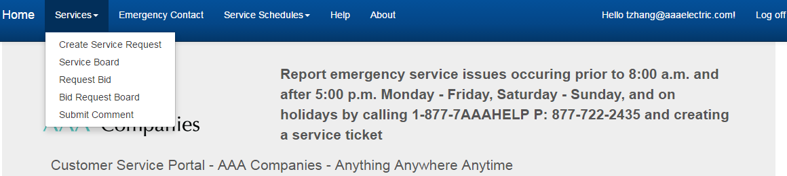
Creating a Service Request
Under “Services”, select “Create Service Request”
Complete the request form then select “Create”
Important Note: For priority level, please note “Emergency” or “Next Day” priority levels
are a premium fee. When possible, select “Next Route Maintenance” as the priority.

Slide 7
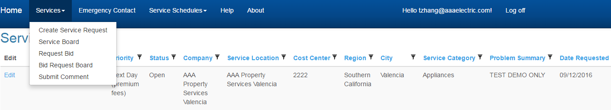
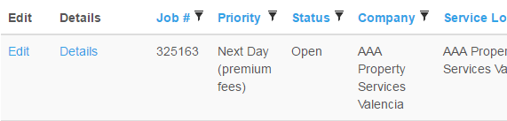
Reviewing Service Tickets Open and Closed
Under “Services”, select “Service Board”
Should you want to edit the request, select “Edit” located on the left.
Details can be added to the “Add Details” section, then select “Save”

Slide 8
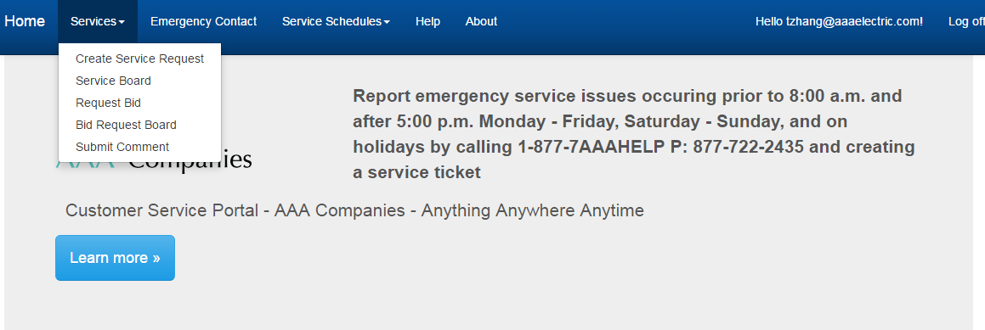
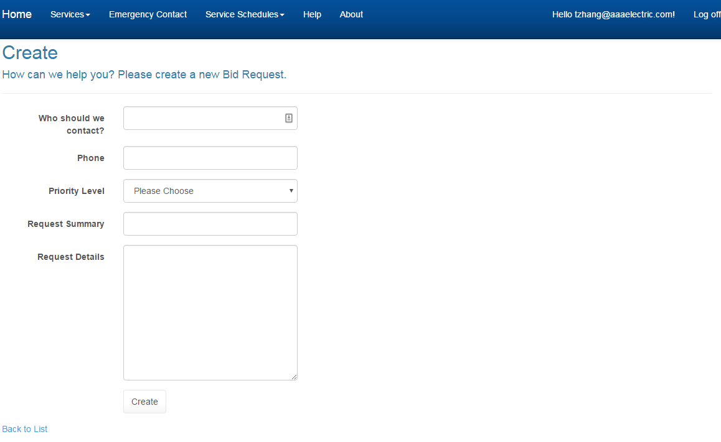
Creating a Bid Request
Under “Services”, select “Request Bid”
Complete the form then select “Create”

Slide 9
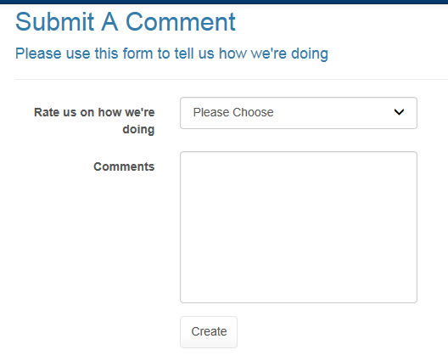
Submitting Comments
Under “Services” select “Submit Comment”
Complete the form, then select “Create”.
Facilities Department reviews these monthly.

Slide 10
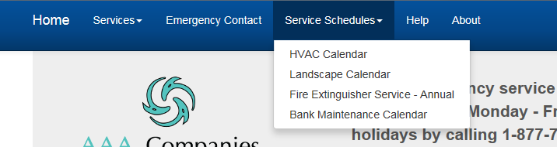
Calendar of Scheduled Services
A list of all scheduled services can be found under “Service Schedules”

Slide 11
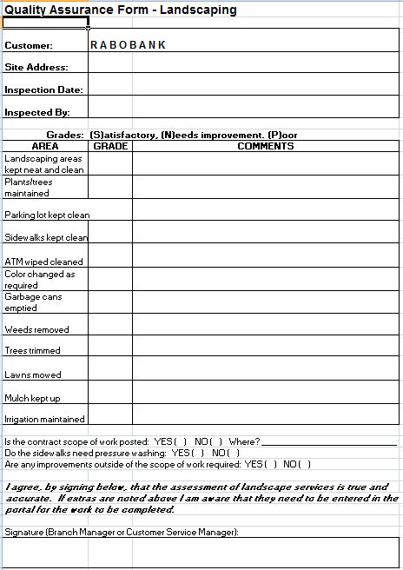
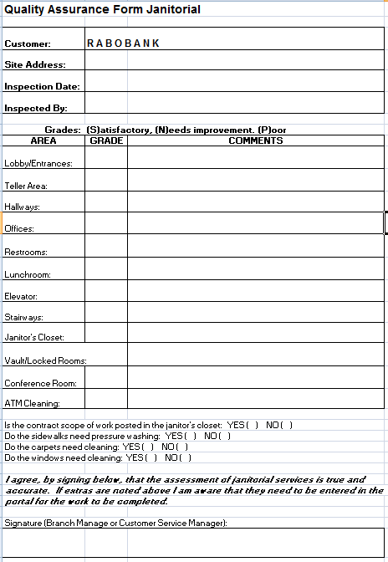
Quality Assurance Forms
Onsite staff will be asked to complete the below Quality Assurance Forms for janitorial monthly and landscaping quarterly. Any general concerns/complaints or unsatisfactory service levels should be reported on this form. AAA Property Services will follow up on each unfavorable report. A copy of the contracted Scope of Work for each service is posted onsite in the janitor closet.

Slide 12
Reporting Afterhours Emergencies
To report emergency service issues
Before 8:00 a.m. or after 5:00 p.m.
Monday-Friday
OR
Saturday, Sunday and Holidays
877-7AA-AHELP
(877-722-2435)
Emergency repairs are a premium fee
Make sure to leave your name and contact information when leaving an afterhours message

Slide 13
Questions?
If you have any facility related questions,
please email the department at
l.us.rna.GSDFacilities@Rabobank.com

